Slide 1
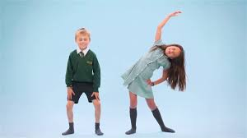
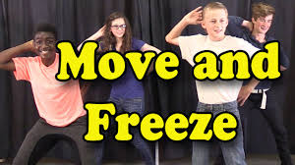
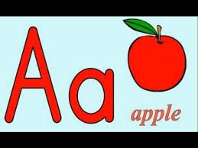
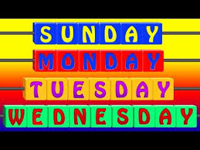
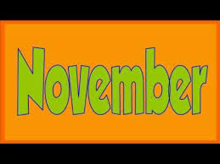
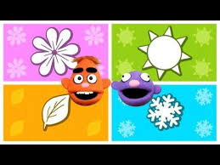
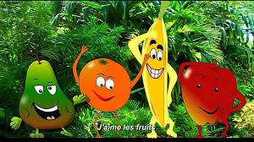
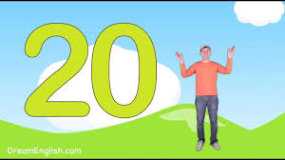
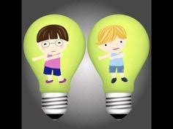
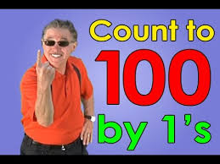
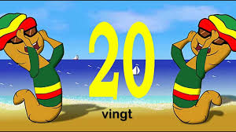
In the lower school, we often use songs and rhymes to help us learn. Here are some of our favourites.
Hello Song Health & Wellbeing https://www.youtube.com/watch?v=MzNlCy9PaNk | Feelings Song Health & Wellbeing https://www.youtube.com/watch?v=UsISd1AMNYU | Shake Up Wake Up Health & Wellbeing https://www.youtube.com/watch?v=1gUbdNbu6ak | Move and Freeze Health & Wellbeing https://www.youtube.com/watch?v=388Q44ReOWE | Bonjour Song French: Greetings https://www.youtube.com/watch?v=NXkJ88ygPY0
A is for Apple Phonics https://www.youtube.com/watch?v=BELlZKpi1Zs | Days Song Maths: Time https://www.youtube.com/watch?v=HtQcnZ2JWsY | Months Song Maths: Time https://www.youtube.com/watch?v=5enDRrWyXaw | Seasons Song Maths: Time https://www.youtube.com/watch?v=ksGiLaIx39c | J’aime les fruits French: Fruits https://www.youtube.com/watch?v=nJ03KjwiIVM
Shape Song Maths: Shape https://www.youtube.com/watch?v=WTeqUejf3D0 | Count to 20 Numeracy https://www.youtube.com/watch?v=0VLxWIHRD4E | Count down from 20 Numeracy https://www.youtube.com/watch?v=srPktd4k_O8 | Count to 100 Numeracy https://www.youtube.com/watch?v=0VLxWIHRD4E | Bonjour! French: Numbers https://www.youtube.com/watch?v=UsEz58BblMY
Notes:
Hello Song Health & Wellbeing https://www.youtube.com/watch?v=MzNlCy9PaNk
Feelings Song Health & Wellbeing https://www.youtube.com/watch?v=UsISd1AMNYU
Shake Up Wake Up Health & Wellbeing https://www.youtube.com/watch?v=1gUbdNbu6ak
Move and Freeze Health & Wellbeing https://www.youtube.com/watch?v=388Q44ReOWE
Bonjour Song French: Greetings https://www.youtube.com/watch?v=NXkJ88ygPY0
A is for Apple Phonics https://www.youtube.com/watch?v=BELlZKpi1Zs
Days Song Maths: Time https://www.youtube.com/watch?v=HtQcnZ2JWsY
Months Song Maths: Time https://www.youtube.com/watch?v=5enDRrWyXaw
Seasons Song Maths: Time https://www.youtube.com/watch?v=ksGiLaIx39c
J’aime les fruits French: Fruits https://www.youtube.com/watch?v=nJ03KjwiIVM
Shape Song Maths: Shape https://www.youtube.com/watch?v=WTeqUejf3D0
Count to 20 Numeracy https://www.youtube.com/watch?v=0VLxWIHRD4E
Count down from 20 Numeracy https://www.youtube.com/watch?v=srPktd4k_O8
Count to 100 Numeracy https://www.youtube.com/watch?v=0VLxWIHRD4E
Bonjour! French: Numbers https://www.youtube.com/watch?v=UsEz58BblMY

